Slide 1
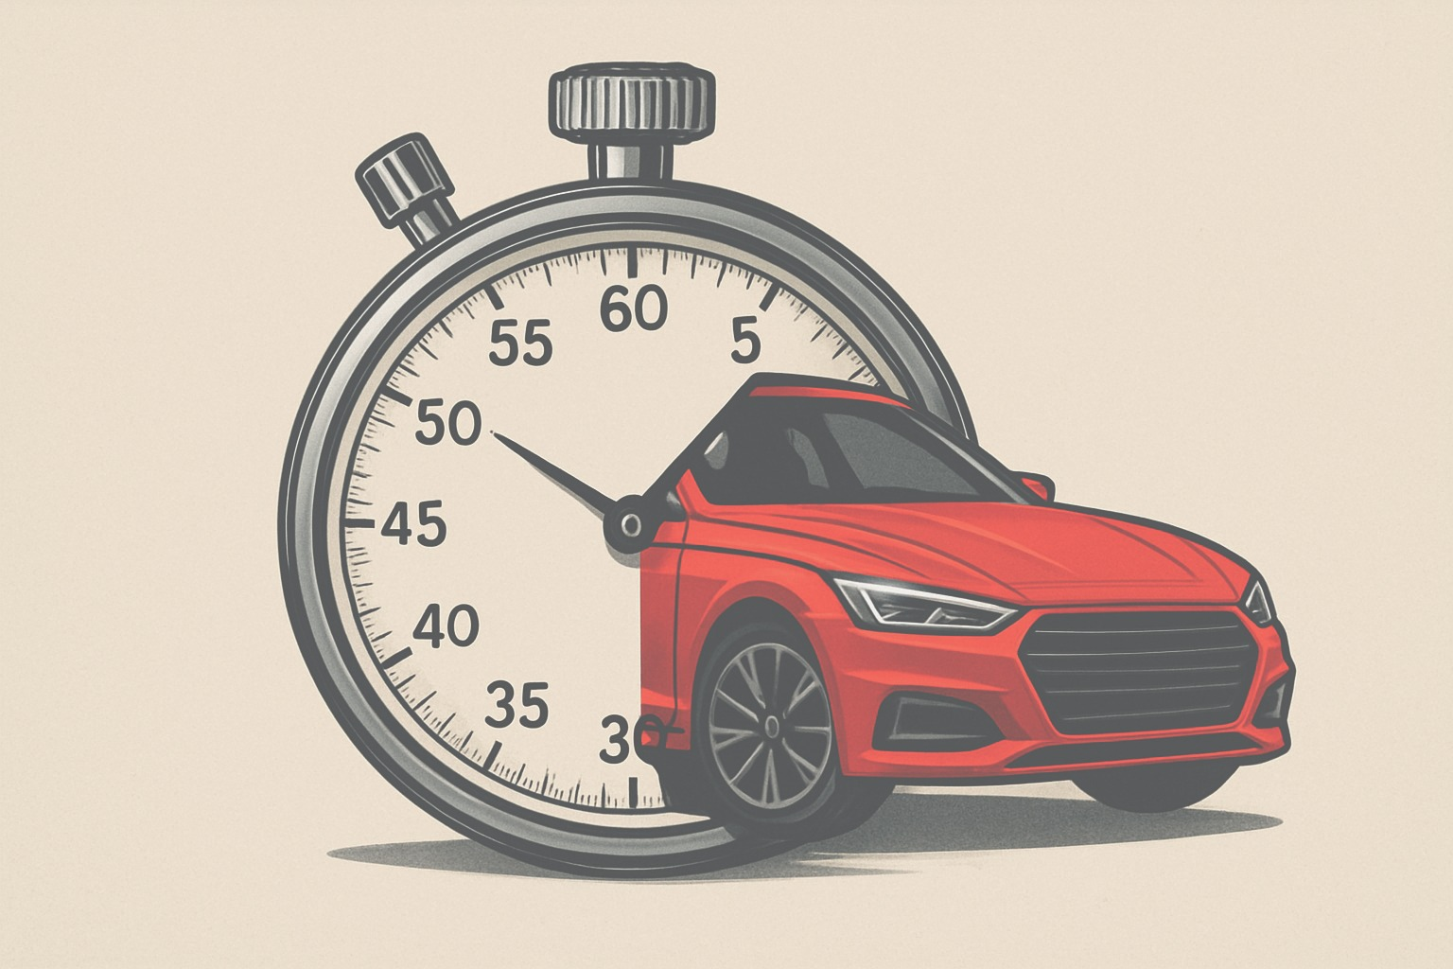
Fleet Resource Optimization with AI Agents
DONE BY
RAMANATH S
HARSHAVARDHAN S
VISWANATHAN S
KESHAV K
VETRIVELAN E

Slide 2
PROBLEM STATEMENT
Fleet Resource Optimization with AI to dynamicallyre-allocate fleet vehicles based on live traffic, weather, and demand data.

Slide 3
THE NEED FOR SMARTER FLEET MANAGEMENT
Growing urban mobility challenges - Urban mobility faces rising congestion, pollution, safety risks, and poor infrastructure, demanding sustainable, accessible, and technology-driven transport solutions.
Increasing traffic congestion & unpredictable weather - Increasing traffic congestion and unpredictable weather worsen urban mobility, causing delays, higher costs, safety concerns, and demanding smarter, adaptive transport solutions.
Rising customer demand for on-time service pressures - Rising customer demand for on-time service pressures urban mobility systems, requiring efficient planning, real-time monitoring, and adaptive, technology-driven transport solutions.

Slide 4
OUR AIM
Optimize fleet resource usage in real time
Improve customer satisfaction
Reduce operational cost & delays
Ensure adaptability to dynamic environments

Slide 5
SYSTEM ARCHITECTURE
Data sources: GPS, Google Map API ( Inclusion of traffic and direction feeds)
AI Agents : Gemini
User/Driver Interface

Slide 6
KEY FEATURES
Real-time traffic & weather adaptation
Demand prediction & forecasting
Multi-agent coordination
Scalability for large fleets
Cost & fuel optimization

Slide 7
CONCLUSION
AI transforms fleet management
Dynamic adaptation ensures efficiency
Dynamic adaptation ensures efficiency
Scalable solution adaptable to multiple industries
Paving the way for future-ready, autonomous fleet ecosystems

